Slide 1


Database Systems
Bushra
bushra@nu.edu.pk

Slide 2
Course Outline
Basic database concepts
Data Model, schema architecture and data independence
Classification of DBMS and Database systems environment.
Relational Model Concepts, Constraints and Relational Databases
Basic SQL
Advanced SQL concepts
Conceptual Modeling
Relational Algebra
Basics of Functional Dependencies and Normalization for Relational Databases
Introduction to Transaction Processing Concepts and Theory
Concurrency Control Techniques
Database Recovery Techniques
NOSQL Databases and Big Data Storage Systems

Slide 3
Books
Text Books
Ramez Elmasri & Shamkant B. Navathe, Database Systems, Models, Languages, Design and Application Programming, 7th Edition, 2016.
Reference Books
Thomas Connolly, Carolyn Begg, Database Systems: A practical approach to design, implementation and Management, 6th Edition, 2015.
C.J. Date, An Introduction to Database Systems, 8th Edition, 2004

Slide 4
Assessment Plan
Assessment | Weightage
Assignment | 10
Mid Exams | 30
Project | 9
Final | 50
Class Participation | 1

Slide 5
A database is a collection of related data.
What is a Database?
Notes:
By data, we mean known facts that can be recorded and that have implicit meaning.
A random assortment of data cannot correctly be referred to as a database.
Sometimes the db is also defined as
A shared collection of logically related data and its description, designed to meet the information needs of an organization.
The database represents the entities, the attributes, and the logical relationships between the entities. In other words, the database holds data that is logically related.

Slide 6
Implicit properties of a database
A database represents the miniworld or the universe of discourse (UoD).
A database is a logically coherent collection of data with some inherent meaning
A database is designed, built, and populated with data for a specific purpose.
Notes:
The definition given was quite general however the common use of the term database is usually more restricted. The database is supposed to have following implicit properties
A database represents some aspect of the real world, sometimes called the miniworld or the universe of discourse (UoD).
Changes to the miniworld are reflected in the database.
a database has some source from which data is derived
some degree of interaction with events in the real world
an audience that is actively interested in its contents
The end users of a database may perform business transactions or events may happen that cause the information in the database to change.
In order for a database to be accurate and reliable at all times, it must be a true reflection of the miniworld that it represents; therefore, changes must be reflected in the database as soon as possible.

Slide 7
Database
A database can be of any size and complexity.
A database may be generated and maintained manually or it may be computerized.
A computerized database may be created and maintained either by a group of application programs written specifically for that task or by a database management system.
Notes:
Example
Contacts saving application (small in size and simple)
Library: may contain half a million entries (a little complex)
Facebook: more than a billion users (a complex app with huge size)

Slide 8
DBMS
The DBMS is a general-purpose software system that facilitates the processes of defining, constructing, manipulating, and sharing databases among various users and applications.

Slide 9
Defining a database
Specifying the data types, structures, and constraints of the data to be stored in the database.
The database definition or descriptive information is also stored by the DBMS in the form of a database catalog or dictionary; it is called meta-data.
Notes:
Example: Library management system database will contain books, members and other information
books will contain data elements name(String), edition(number), author(String)
Constraints can be like book name cannot be empty

Slide 10
Constructing and Manipulating a database
Constructing a database
Storing the data on some storage medium that is controlled by the DBMS.
Manipulating a database
functions such as querying the database to retrieve specific data, updating the database to reflect changes in the miniworld, and generating reports from the data.
Notes:
Constructing the db store data to represent each book/person/issue_book
Notice that records in the various files may be related. Like person and book issued will require person id as well as book information
Manipulating a database
Example:
retrieve book with name fundamentals of database systems
update the edition of any book

Slide 11
Sharing a database
Sharing a database allows multiple users and programs to access the database simultaneously.

Slide 12
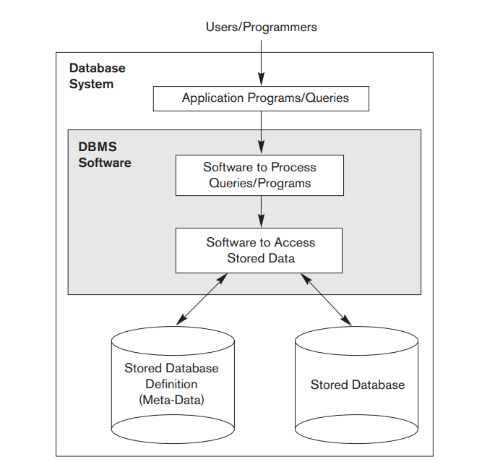
A Simplified Database Environment
Notes:
An application program accesses the database by sending queries or requests for data to the DBMS.

Slide 13
Other Important Functions
Protecting the database
system protection against hardware or software malfunction (or crashes)
security protection against unauthorized or malicious access.
Maintaining it over a long period of time.
Notes:
Protection
system protection against hardware or software malfunction (or crashes)
security protection against unauthorized or malicious access.
Maintain
A typical large database may have a life cycle of many years, so the DBMS must be able to maintain the database system by allowing the system to evolve as requirements change over time.
To complete our initial definitions, we will call the database and DBMS software together a database system

Slide 14
File based approach

Slide 15
Manual Filing System
File-based systems were an early attempt to computerize the manual filing system.
Example: An ecommerce company abc might have physical files set up to hold all external and internal correspondence relating to a product, client, or employee.
Manual filing systems breaks down when we have to cross-reference or process the information in the files.
Example: eCommerce site where manager wants annual report of best selling products among the loyal customers of the company in the city karachi. This query will require data from clients, products, and sales files
Notes:
Increasingly nowadays, clients, senior managers, and staff want more and more information. In some business sectors, there is a legal requirement to produce detailed monthly, quarterly, and annual reports. Clearly, the manual system is inadequate for this type of work.

Slide 16
File Based Approach
a decentralized approach
where each department stored and controlled its own data
Data processing department would write programs for each application each office needs.
The queries and the file structure would be hard-coded within each program
Notes:
The file-based system was developed in response to the needs of industry for more efficient data access.
For example, HR keeps employee, recruitment, employee contract and other details whereas another department of finance keeps record of employees and finances throughout the organization

Slide 17
Limitations of File Processing Approach
Separation and isolation of data
it is more difficult to access data that should be available.
Duplication of data
redundancy in defining and storing data results in wasted storage space
in redundant efforts to maintain common up-to-date data.
Notes:
When data is isolated in separate files, it is more difficult to access data that should be available.
Duplication is wasteful. It costs time and money to enter the data more than once.
It takes up additional storage space, again with associated costs. Often, the duplication of data can be avoided by sharing data files.
Perhaps more importantly, duplication can lead to loss of data integrity; in other words, the data is no longer consistent.
For example, consider the duplication of data between the Payroll and HR Departments described previously. If a member of staff moves and the change of address is communicated only to HR and not to Payroll, the person’s paycheck will be sent to the wrong address.

Slide 18
Limitations of File Processing Approach
Program - Data dependence
physical structure and records are defined in the application code
changes to an existing structure are difficult to make.
Example: if the employee name field is changed from 40 to 50 characters, then all programs that use a file which contains the employee name field will need to be updated.
Additionally, the DP department must write a program to transform each file that contains the employee name field to the new format
Notes:
the physical structure and storage of the data files and records are defined in the application code
For example, increasing the size of the employee name field from 40 to 41 characters sounds like a simple change, but it requires the creation of a one-off program (that is, a program that is run only once and can then be discarded) that converts the employee file to the new format. This program has to:
Open the original employee file for reading
Open a temporary file with the new structure
Read a record from the original file, convert the data to conform to the new structure, and write it to the temporary file, then repeat this step for all records in the original file
Delete the original employee file
Rename the temporary file as employee
In addition, all programs that access the employee file must be modified to conform to the new file structure

Slide 19
Limitations of File Processing Approach
Incompatible file formats
the structures are dependent on the application programming language as the structure is embedded in application programs.
Fixed queries/proliferation of application programs
file-based systems are very dependent upon the application developer, who has to write any queries or reports that are required.
Notes:
Because the structure of files is embedded in the application programs, the structures are dependent on the application programming language.
For example, the structure of a file generated by a COBOL program may be different from the structure of a file generated by a C program. The direct incompatibility of such files makes them difficult to process jointly. For example, suppose that the Contracts Department wants to find the names and addresses of all owners whose property is currently rented out. Unfortunately, Contracts does not hold the details of property owners; only the Sales
the requirement for new or modified queries grew. However, file-based systems are very dependent upon the application developer, who has to write any queries or reports that are required. As a result, two things happened.
In some organizations, the type of query or report that could be produced was fixed. There was no facility for asking unplanned (that is, spur-ofthe-moment or ad hoc) queries either about the data itself or about which types of data were available.
In other organizations, there was a proliferation of files and application programs. Eventually, this reached a point where the DP Department, with its existing resources, could not handle all the work.

Slide 20
Database Approach

Slide 21
Database Approach
A single repository maintains data that is defined once and then accessed by various users repeatedly through queries, transactions, and application programs.
Notes:
Instead of disconnected files with redundant data, all data items are integrated with a minimum amount of duplication.

Slide 22
Characteristics of Database Approach
Notes:
Compare db approach with file based approach

Slide 23
Self-describing nature of a database system
The database system contains not only the database itself but also.
The database holds not only the database, but also metadata.
Thus, a database is also self-describing collection of integrated records
Notes:
DBMS catalog is used by the DBMS software and also by database users who need information about the database structure
The description of the data is known as the system catalog (or data dictionary or metadata—the “data about data”).
File processing:
Data definition is typically part of the application programs themselves.
Hence, these programs are constrained to work with only one specific database

Slide 24
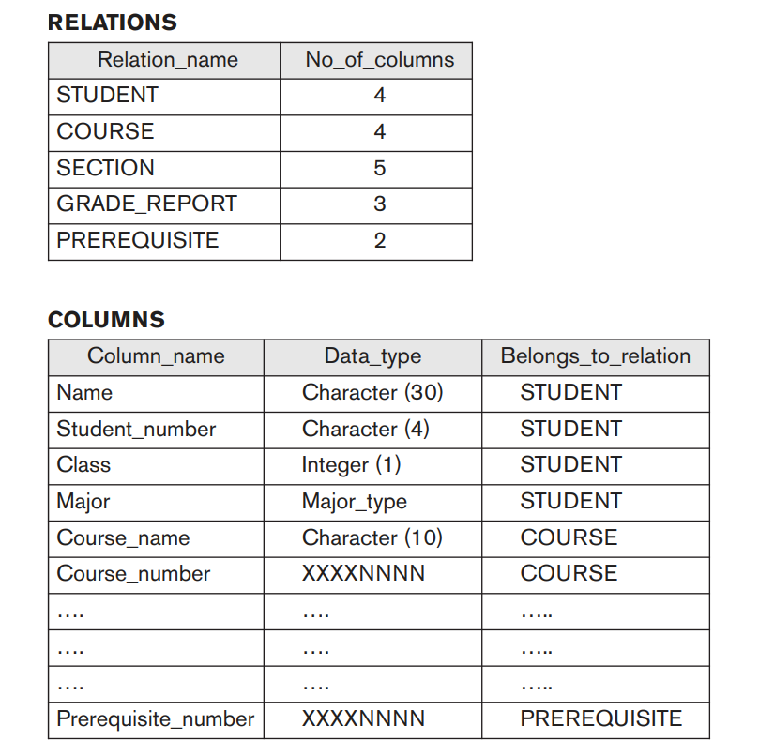
Self-describing nature of a database system
Notes:
Figure shows some entries in a database catalog.
Whenever a request is made to access, say, the Name of a STUDENT record, the DBMS software refers to the catalog to determine the structure of the STUDENT file and the position and size of the Name data item within a STUDENT record.
In a typical file-processing application, the file structure and, in the extreme case, the exact location of Name within a STUDENT record are already coded within each program that accesses this data item.

Slide 25
Insulation between Programs and Data
In traditional file processing,
the structure of data files is embedded in the application programs, so any changes to the structure of a file may require changing all programs that access that file.
DBMS have this property called program data independence, where:
access programs do not require such changes in most cases.
The structure of data files is stored in the DBMS catalog separately from the access programs.
Notes:
It is the self-describing nature of a database that provides program–data independence

Slide 26
Insulation between Programs and Data
Example:
If we want to add another piece of data to each STUDENT record, say the Birth_date, we only need to change the description of STUDENT records in the catalog; no programs are changed.
The next time a DBMS program refers to the catalog, the new structure of STUDENT records will be accessed and used.
Notes:
a file access program may be written in such a way that it can access only STUDENT records of the structure. If we want to add another piece of data to each STUDENT record, say the Birth_date, such a program will no longer work and must be changed
By contrast, in a DBMS environment, we only need to change the description of STUDENT records in the catalog to reflect the inclusion of the new data item Birth_date; no programs are changed. The next time a DBMS program refers to the catalog, the new structure of STUDENT records will be accessed and used
The approach taken with database systems, where the definition of data is separated from the application programs, is similar to the approach taken in modern software development, where an internal definition of an object and a separate external definition are provided. The users of an object see only the external definition and are unaware of how the object is defined and how it functions

Slide 27
Insulation between Programs and Data
Program-operation independence
In some database systems:
users can define operations on data as part of the database definitions
An operation (also called a function or method) is specified in two parts.
The interface (or signature) of an operation
The implementation (or method) of the operation is specified separately
User programs can operate on the data by invoking these operations, regardless of how the operations are implemented.
Notes:
For example, an operation CALCULATE_GPA can be applied to a STUDENT object to calculate the grade point average. Such operations can be invoked by the user queries or application programs without having to know the details of how the operations are implemented.

Slide 28
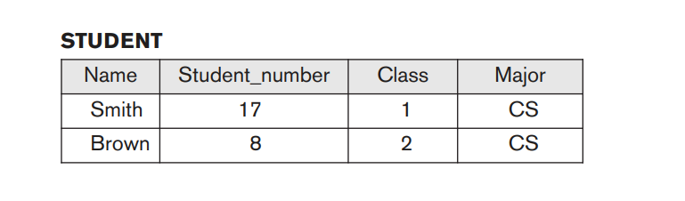
Data Abstraction
A DBMS provides users with a conceptual representation of data that does not include many of the details of how the data is stored or how the operations are implemented.
Informally, a data model is a type of data abstraction that is used to provide this conceptual representation.
Conceptual representation of Student records
Notes:
The characteristic that allows program-data independence and program-operation independence is called data abstraction.
The data model uses logical concepts, such as objects, their properties, and their interrelationships, that may be easier for most users to understand than computer storage concepts.
Hence, the data model hides storage and implementation details that are not of interest to most database users.

Slide 29
Characteristics of Database Approach
Support of Multiple Views of the Data
A multiuser DBMS whose users have a variety of distinct applications must provide facilities for defining multiple views.
Sharing of Data and Multi-User Transaction Processing
A multiuser DBMS must allow multiple users to access the database at the same time.
The DBMS must include concurrency control software to ensure that several users trying to update the same data do so in a controlled manner so that the result of the updates is correct.
Notes:
A database typically has many types of users, each of whom may require a different perspective or view of the database.
For example, one user of the database of may be interested only in accessing and printing the transcript of each student. A second user, who is interested only in checking that students have taken all the prerequisites of each course for which the student registers, may require a different view
A view may be a subset of the data in the database or it may contain virtual data that is derived from the database but is not explicitly stored.
Example of multi user transaction
For example, when several reservation agents try to assign a seat on an airline flight, the DBMS should ensure that each seat can be accessed by only one agent at a time for assignment to a passenger. T
A fundamental role of multiuser DBMS software is to ensure that concurrent transactions operate correctly and efficiently.

Slide 30
Advantages of using DBMS
Controlling Redundancy
Restricting Unauthorized Access
Providing Persistent Storage for Program Objects
Databases can be used to provide persistent storage for program objects and data structures.
Object-oriented database systems are compatible with programming languages
Drawing inferences and actions from the stored data
Notes:
Some additional advantages of using a DBMS and the capabilities that a good DBMS should possess. These capabilities are in addition to the four main characteristics discussed in Section 1.3.
Providing Persistent Storage for Program Objects
Databases can be used to provide persistent storage for program objects and data structures.
Programming languages typically have complex data structures, such as structs or class
The values of program variables or objects are discarded once a program terminates\
If the programmer stores them in permanent files, then often they have to convert it into format suitable for file storage.
When the need arises to read this data once more, they are again converted from the file format to the program variable or object structure.
Object-oriented database systems are compatible with programming languages such as C++ and Java, and the DBMS software automatically performs any necessary conversions. Hence, a complex object in C++ can be stored permanently in an object-oriented DBMS

Slide 31
Advantages of using DBMS
Providing Storage Structures and Search Techniques for Efficient Query Processing
Providing Backup and Recovery
Providing Multiple User Interfaces
Representing Complex Relationships among Data
Enforcing Integrity Constraints
Potential for Enforcing Standards.
Reduced Application Development Time.
Development time using a DBMS is estimated to be one sixth to one-fourth of that for a file system
Notes:
Providing Storage Structures and Search Techniques for Efficient Query Processing
DBMS must provide specialized data structures and search techniques to speed up disk search for the desired records.
Providing Backup and Recovery
A DBMS must provide facilities for recovering from hardware or software failures. The backup and recovery subsystem of the DBMS is responsible for recovery.
Representing Complex Relationships among Data
A database may include numerous varieties of data that are interrelated in many ways.
Enforcing Integrity Constraints
Database integrity ensures that the data in the database in valid, accurate and consistent
It ensures user trust on the database
Potential for Enforcing Standards.
The database approach permits the DBA to define and enforce standards among database users in a large organization.
Reduced Application Development Time.
Development time using a DBMS is estimated to be one sixth to one-fourth of that for a file system
A prime selling feature of the database approach is that developing a new application—such as the retrieval of certain data from the database for printing a new report—takes very little time. Designing and implementing a large multiuser database from scratch may take more time than writing a single specialized file application. However, once a database is up and running, substantially less time is generally required to create new applications using DBMS facilities

Slide 32
Advantages of using DBMS
Flexibility.
Availability of Up-to-Date Information.
Economies of Scale.
Data consistency
By eliminating or controlling redundancy, we reduce the risk of inconsistencies occurring.
Notes:
Modern DBMSs allow certain types of evolutionary changes to the structure of the database without affecting the stored data and the existing application programs.
Economies of Scale.
The DBMS approach permits consolidation of data and applications, thus reducing the amount of wasteful overlap between activities of data-processing personnel in different projects or departments as well as redundancies among applications. This enables the whole organization to invest in more powerful processors, storage devices, or networking gear, rather than having each department purchase its own (lower performance) equipment. This reduces overall costs of operation and management.

Slide 33
Disadvantages of DBMS
Complexity
Size
Cost of DBMS
Maintenance Cost
Additional Hardware Cost
Greater impact of a failure
Notes:
Size The complexity and breadth of functionality makes the DBMS an extremely large piece of software, occupying many megabytes of disk space and requiring substantial amounts of memory to run efficiently
Cost of DBMSs The cost of DBMSs varies significantly, depending on the environment and functionality provided. For example, a single-user DBMS for a personal computer may only cost $100. However, a large mainframe multi-user DBMS servicing hundreds of users can be extremely expensive, perhaps $100,000 or even $1,000,000. There is also the recurrent annual maintenance cost, which is typically a percentage of the list price.
DBMS may involve unnecessary overhead costs in some situations that would not be incurred in traditional file processing:
High initial investment in hardware, software, and training
The generality that a DBMS provides for defining and processing data
Overhead for providing security, concurrency control, recovery, and integrity functions
Additional hardware costs The disk storage requirements for the DBMS and the database may necessitate the purchase of additional storage space. Furthermore, to achieve the required performance, it may be necessary to purchase a larger machine, perhaps even a machine dedicated to running the DBMS. The procurement of additional hardware results in further expenditure
Greater impact of a failure The centralization of resources increases the vulnerability of the system. Because all users and applications rely on the availability of the DBMS, the failure of certain components can bring operations to a halt.

Slide 34
When not to use a DBMS
In a few situations DBMS may involve unnecessary overhead costs that would not be incurred in traditional file processing.
Therefore, it may be more desirable to develop customized database applications under the following circumstances:
Simple, well-defined database applications that are not expected to change at all
No multiple-user access to data
Embedded systems with limited storage capacity, where a general-purpose DBMS would not fit
Notes:
The overhead costs of using a DBMS are due to the following:
High initial investment in hardware, software, and training
The generality that a DBMS provides for defining and processing data
Overhead for providing security, concurrency control, recovery, and integrity functions

Slide 35
When not to use a DBMS
If the database system is not able to handle the complexity of data because of modeling limitations (e.g., in complex genome and protein databases)
If the database users need special operations not supported by the DBMS (e.g., GIS and location based services).
Stringent, real-time requirements for some application programs that may not be met because of DBMS overhead

Slide 36
Discussion on
Files vs Databases
Notes:
A database is generally used for storing related, structured data, with well defined data formats, in an efficient manner for insert, update and/or retrieval (depending on application).
On the other hand, a file system is a more unstructured data store for storing arbitrary, probably unrelated data.
For very complex operations, the filesystem is likely to be very slow.
A file processing system is a collection of programs that store and manage files in computer hard-disk.
On the other hand, A database management system is collection of programs that enables to create and maintain a database.
File processing system has more data redundancy, less data redundancy in dbms.
File processing system provides less flexibility in accessing data, whereas dbms has more flexibility in accessing data.
File processing system does not provide data consistency, whereas dbms provides data consistency through normalization.
File processing system is less complex, whereas dbms is more complex.
Files are cost effective whereas databases are more secure
File based system
1. The data and program are inter-dependent.
2. File-based system caused data redundancy. The data may be duplicated in different files.
3. File –based system caused data inconsistency. The data in different files may be different that cause data inconsistency.
4. The data cannot be shared because data is distributed in different files.
5. In file based system data is widely spread. Due to this reason file based system provides poor security.
6. File based system is less complex system.
7. File based system takes much space in the system, and memory is wasted in this approach.
8. To generate different report to take a crucial decision is very difficult in file based system.
9. File based system does not provide concurrency facility.
10. File based system does not provide data atomicity functionality.
11. It is difficult to maintain as it provides less controlling facility.
12. If one application fail it does not affects other files in system.
13. No backup and recovery process.
Database system
1. The data and program are independent of each other.
2. Database system control data redundancy. The data appeared only once in the system.
3. In database system data always consistent. Because data appeared only once.
4. In database data is easily shared because data is stored at one place.
5. It provides many methods to maintain data security in the database.
6. Database system is very complex system.
7. Database approach store data more efficiently it takes less space in the system and memory is not wasted.
8. The report can be generated very easily in required format in database system. Because data in database is stored in an organized manner. And easily retrieve to generate different report.
9. Database system provides concurrency facility.
11. Database provides many facility to maintain program.
12. If database fail it affects all application that dependent on database.
13. Backup and recovery process is available.

